Slide 1
22. KAVYAM PATEL 10TH A
Science Portfolo

Slide 2
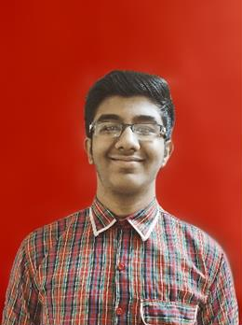
INTRODUCTION
Name: Kavyam Patel
Class: X
Section: A
Roll No.: 22
Father’s Name: Narender Patel
Mother’s Name: Shobhana Patel
I
School Email | Personal Email | Google Drive

Slide 3
INDEX
Introduction I
Index II
Personal Thoughts 1
Activities
Vacation Assignment 2
II

Slide 4
PERSONAL THOUGHTS
Science has been a subject of great interest for me since Elementary School,
which the Teachers and the School itself, especially Mrs. Preeti Sama Ma’am, have
fueled extensively.
Science has had excruciating affects in my life, from understanding daily activities to
mind boggling, though fascinating, rocket science has become as clear as a bell.
1

Slide 5

VACATION ASSIGNMENT
The Vacation assignment was an intuitive
activity to make us think about the environment
with usage of much liked software programs.
Click here for direct link.
2

Slide 6
PRACTICALS
Practicals
Experiment 1 - Find pH using pH paper / Universal Indicator.
Experiment 2 - Role of Carbon Dioxide during respiration.
Experiment 5 - Determine the Focal Length of Concave Mirror.
Experiment 6 - Trace Path of Light through Glass Slab

